Slide 1

Predicting Machinery Downtime
Ahsan Ahmad Charlie Vandel Scott Silverstein Rylan Tribush

Slide 2


Business Problem
Downtime Costs
Machines fail unexpectedly. Output drops. Deadlines missed.
Notes:
What happens when production stops unexpectedly?
At Swire Coca-Cola, unplanned machinery breakdowns halt production, delaying your ability to meet demand. It disrupts operations and lowers output.
This slide represents the impact of mechanical failures across our facilities. It’s a constant battle to keep everything running smoothly.
We need a solution that allows us to stay ahead of these breakdowns

Slide 3
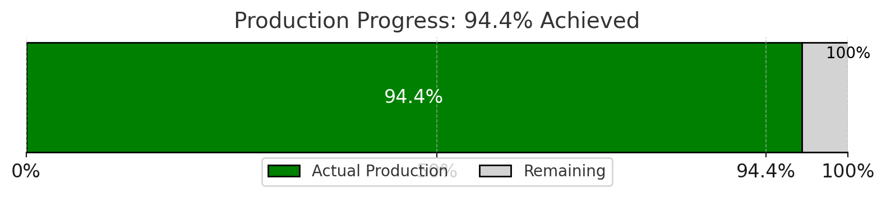

IMPACT
Efficiency Matters.
-$60M
Notes:
Right now, we’re achieving 94.4% of our target output. That gap may not sound large, but for us, it means we’re leaving potential on the table.
Downtime not only affects production but also strains resources, creates inefficiencies, and puts additional pressure on our teams, and is costing Swire $60M
But, obviously we all know this, the question is, how can we make sure we hit 100%?

Slide 4
What success looks like
Reliable: Machines running consistently without unexpected stoppages.
Efficient: Maximized output with minimal delays.
Scalable: A solution that grows with your production needs.

Slide 5
Solution
Collect Data
Gather real-time and historical data from machinery, sensors, and maintenance logs.
Plan Maintenance
Analyze Patterns
Schedule proactive repairs.
Understand the factors that contribute to frequent breakdowns.
Predict Failures
Leverage machine learning models and survival analysis to forecast potential downtimes
Notes:
By analyzing data from the machines, we can predict when a breakdown is likely to occur. This allows us to prevent failures through scheduled maintenance and ensures optimal performance. This isn’t just a plan; it’s a proactive step toward transforming our operations.

Slide 6
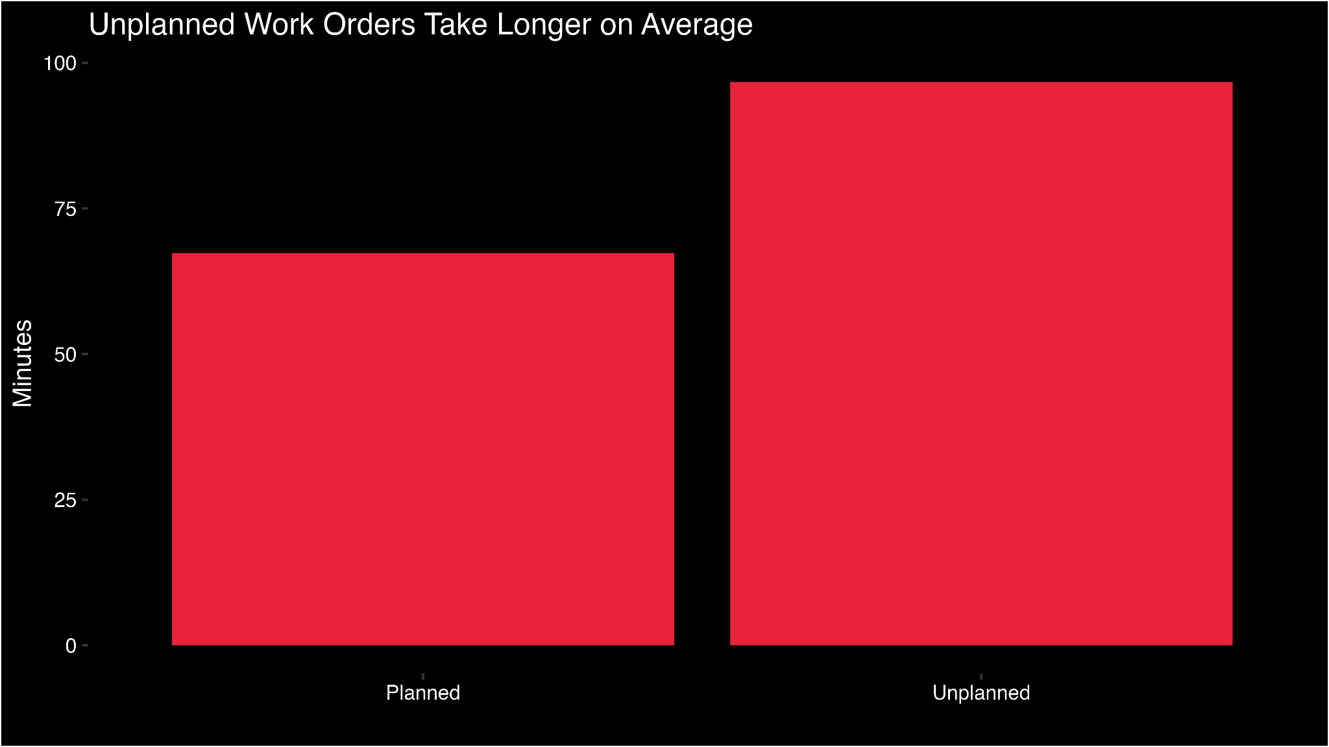
Failure types
Notes:
The average planned downtimes are less than unplanned downtimes

Slide 7
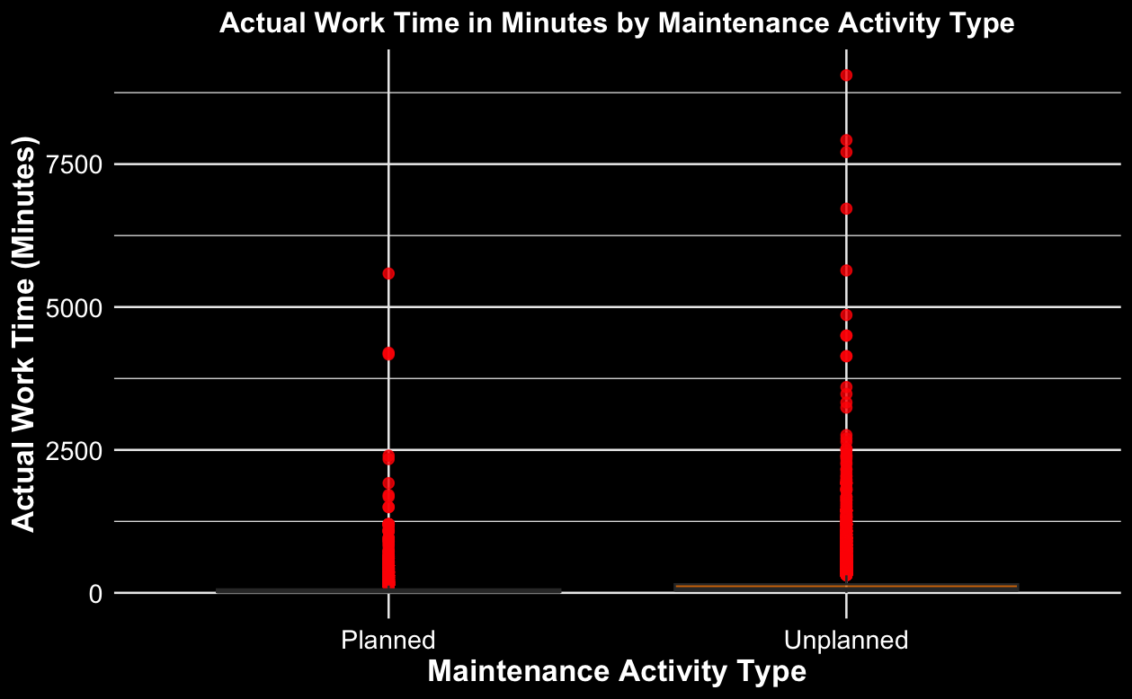
Failure Types Cont.

Slide 8
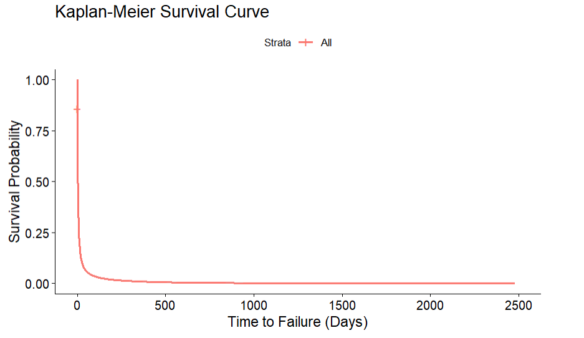
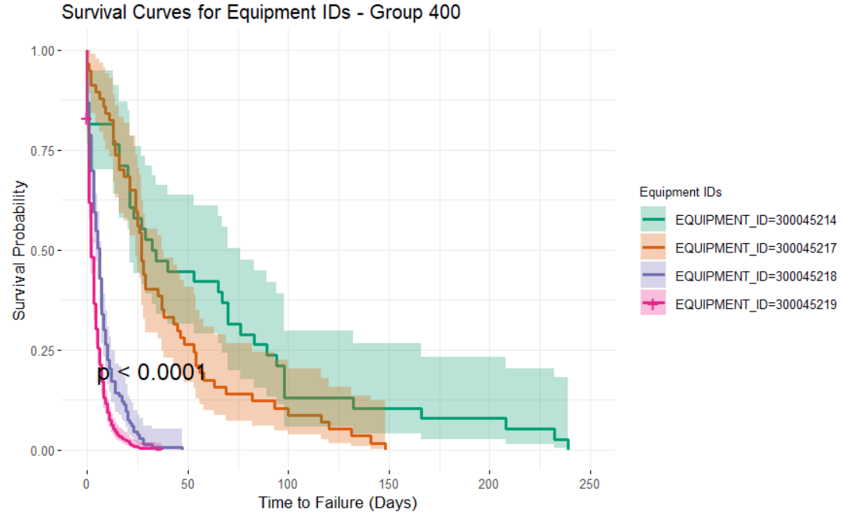
Our Solution: Survival Analysis
A statistical approach to model the time until an event occurs e.g. machine failure
Improves Maintenance Planning to reduce downtime and cost
Identifies high risk Equipment that contributes to failure
Kaplan-Meier Survival Curve to show survival probability across all 7 years
p-value: <0.0001

Slide 9
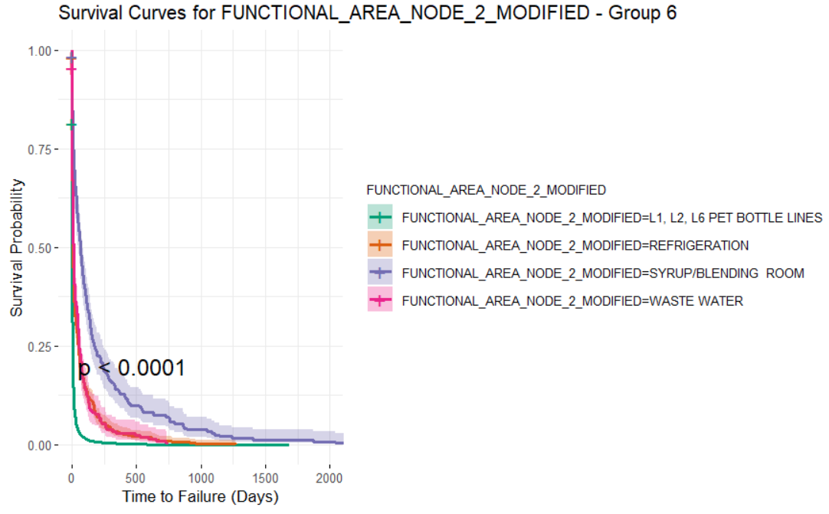
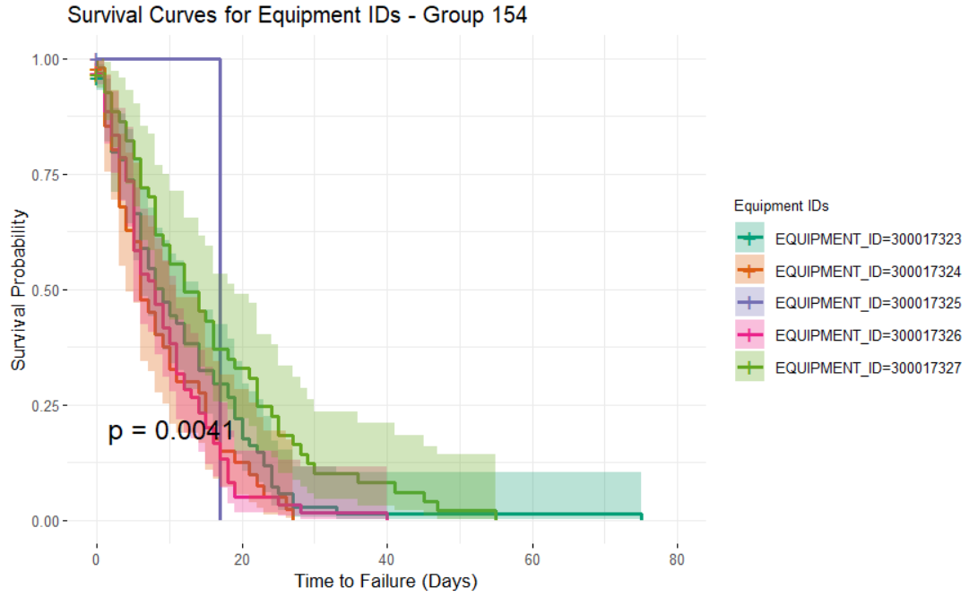
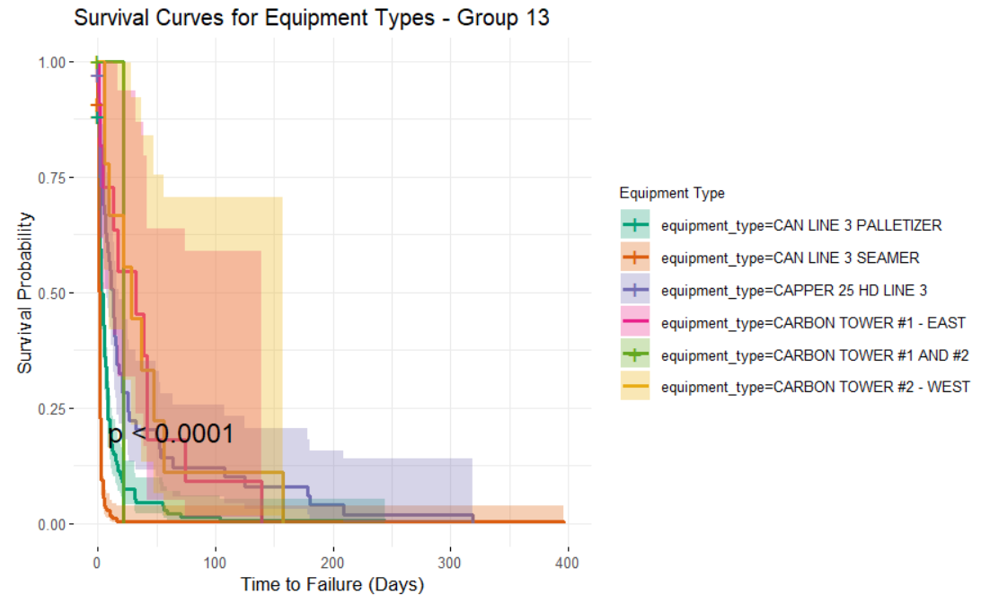
Survival Analysis Across Multiple Granularities
Survival Analysis at Varying Levels of Detail:
From Functional Area to Equipment Types to Equipment IDs
A total of 2956 Survival Curves were created for each Equipment ID, limited p-value due to the proportion of data available

Slide 10
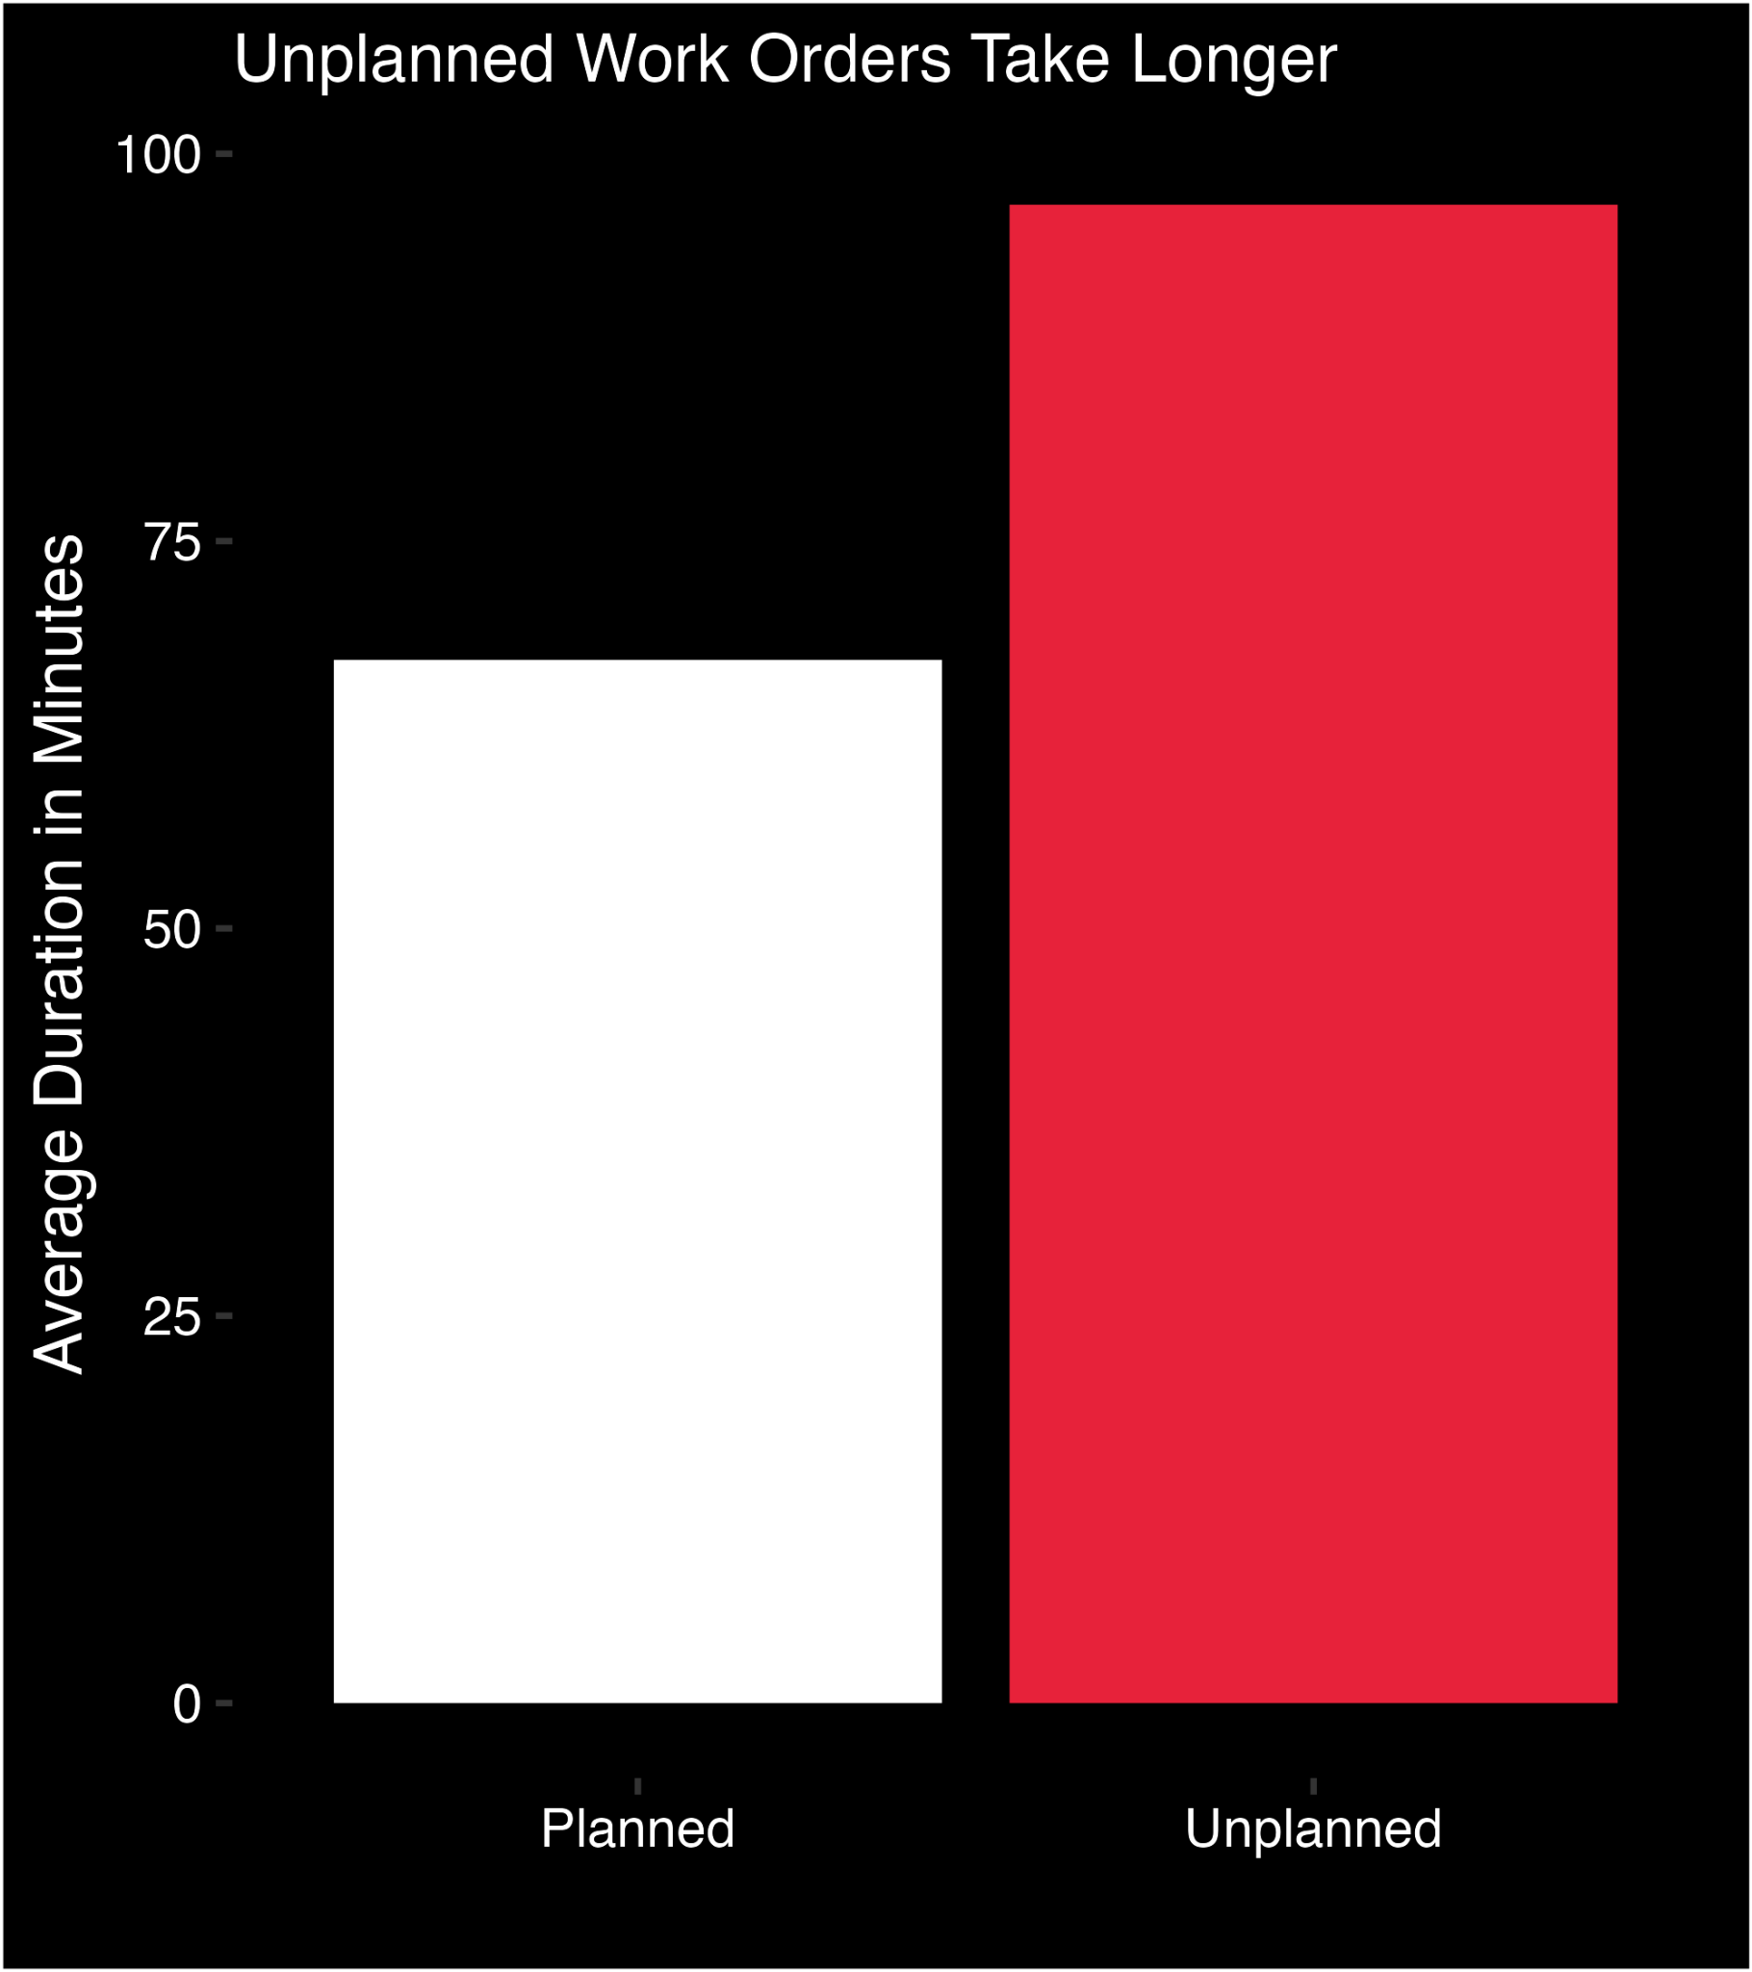
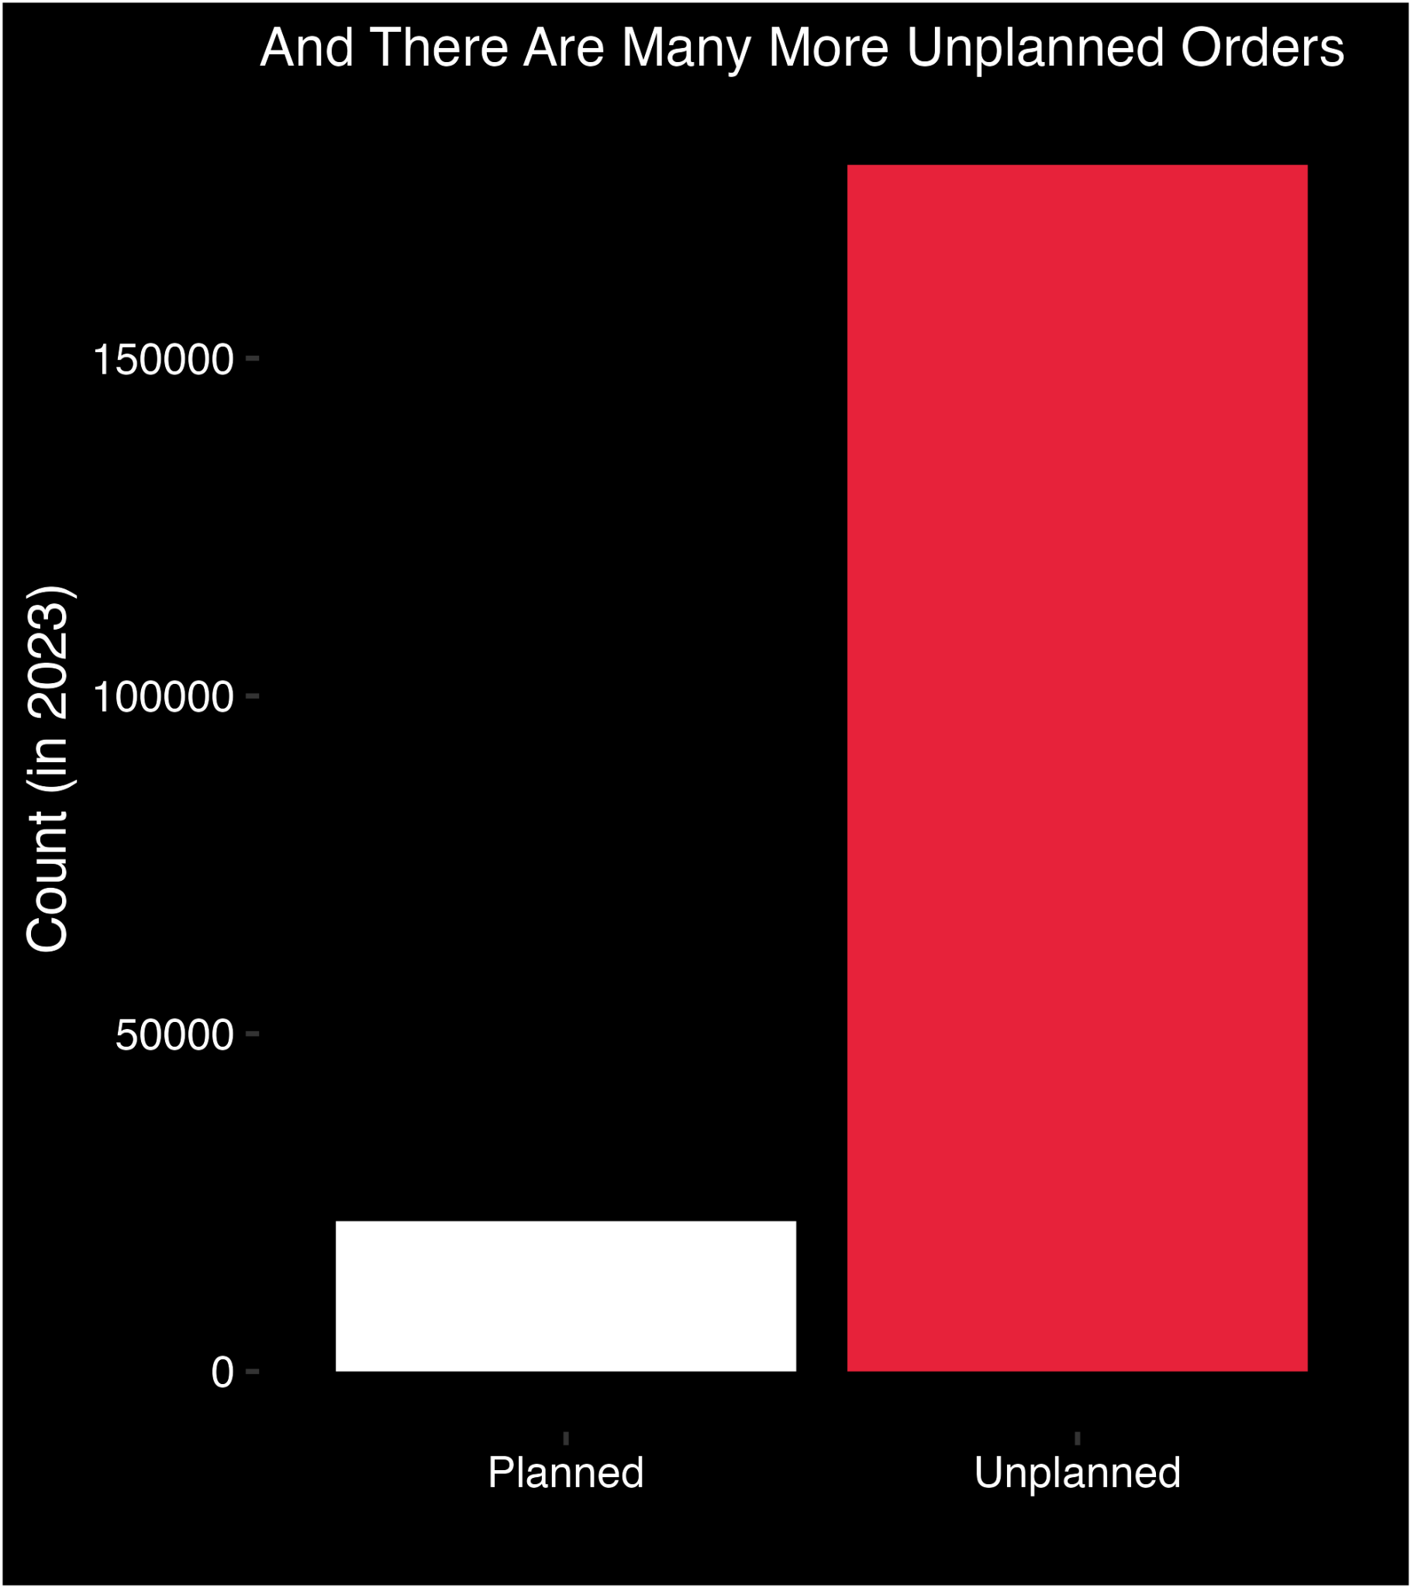

Slide 11
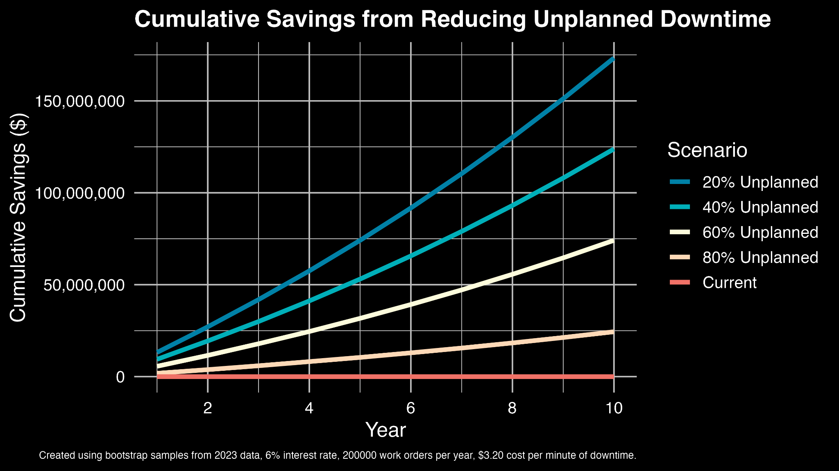

Slide 12

Thank You!

